Slide 1
An efficient approach for performing Sequential Pattern mining in distributed frameworks using co-occurrence information
Jakshat Desai
16JE001854

Slide 2
Introduction

Slide 3
Introduction to sequential pattern mining
What is sequential pattern mining?
itemset
k-itemset
sequence
k-sequence
sequence database
subsequence
support of a sequence
relative support
minimum support

Slide 4
Introduction to Sequential Pattern mining algorithms
sequence extension
itemset extension
Apriori property
Difference between depth first, breadth first and pattern growth sequential pattern mining algorithms
Features of the three classes of sequential pattern mining algorithms

Slide 5
Some Serial Sequential Pattern mining algorithms
Generalized Sequential Patterns(GSP): AprioriAll based breadth first approach, incorporates time gap constraints, better than AprioriAll - generates less candidates and is faster, elements of different transactions can be considered in the same sequence depending on time window,
Prefix-projected Sequential PatterN mining(PrefixSpan): Pattern growth algorithm, uses the concept of projected databases like freeSpan but only considers frequent prefixes instead of frequent subsequences, projected databases always keep shrinking, cost of creating projected databases solved using optimizations like item pruning in projected databases and pseudo projection, performs better than FreeSpan as well as GSP.
Sequential PAttern Mining(SPAM): Depth first, entire database should fit in main memory, depth first traversal of lexicographic tree of sequences for candidate generation, vertical bitmap data structure for support counting, faster than PrefixSpan but highly memory intensive.

Slide 6
Some Parallel Sequential Pattern Mining Algorithms
What is the need for parallel algorithms?
(DPF)Data Parallel Formulation, (STPF)Static Task-Parallel Formulation and (DTPF)Dynamic Task-Parallel Formulation algorithm: pattern growth, similar to PrefixSpan, projected databases, lexicographic tree of sequences,partition problem into smaller parts and solve them parallely, dynamic assignment of work to idle processors increases speedup but causes load imbalance, multiple input scans, high I/O overhead, high communication overhead.
Distributed Progressive Sequential Patterns(DPSP): Breadth first, AprioriAll based, improvement over DGSP, time gap constraints, removes itemsets which arent of any use, iterative MapReduce approach which leads toi load imbalance, does not perform well when it comes to mining long sequential patterns

Slide 7
Some Parallel Sequential Pattern Mining Algorithms
Sequential PAttern Mining on the Cloud(SPAMC): Depth first, based on SPAM, lexicographic tree of sequences, iterative MapReduce approach, high cost of repeatedly loading data, bitmap data structure, unable to handle large databases.
SPAMC-Uniform Distributed Lexical sequence Tree(SPAMC-UDLT): Improvement over SPAMC, highly scalable, doesn't require numerous rounds of MapReduce, better load balancing, faster than SPAMC, doesn't deal with gap constraints, doesn't provide output in condensed representations.
Hybrid algorithms such as ACME, MG-FSM,MG-FSM+, etc

Slide 8
Common drawbacks associated with Parallel Sequential Pattern mining algorithms
iterative MapReduce approach
large communication and I/O overhead
multiple database scans
poor scalability
load imbalancing
Inability to handle constraints

Slide 9
Importance of good Parallel Sequential Mining Algorithms
Data already present in distributed storages
Memory constraints which don't allow data to be brought to a single machine
Single machine may not have enough memory and processing power required for mining
Uses of Parallel sequential pattern mining: health care, web usage mining, bioinformatics, telecommunication, intrusion detection, etc

Slide 10
Distributed Sequential Pattern mining using Co-occurrence information(DSPC)

Slide 11
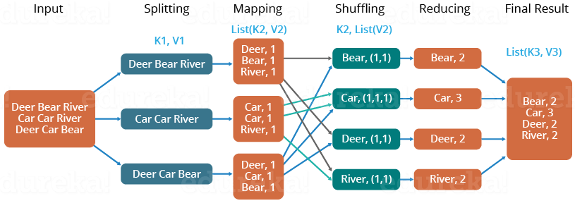
Introduction
Traits of a good parallel sequential pattern mining algorithm: non-iterative MapReduce approach, prunes infrequent sequences as early as possible and prior to support counting, allows fast support counting
Working of a MapReduce programme:

Slide 12
Introduction
DSPC overview: Sequence Index list(SIL) for fast support counting, CMAP_{i} and CMAP_{s} to discard infrequent sequences, two MapReduce jobs, first job to compute CMAP_{i} and CMAP_{s} and second job to find frequent patterns by generating SILs.

Slide 13
Important terms and concepts
Important terms: Sequence Index List(SIL), succeeding by itemset extension, succeeding by sequence extension, co-occurrence list of an item succeeded by itemset extension, co-occurrence list of item succeeded by sequence extension, Co-occurrence Map of a sequence database with respect to itemset extension(CMAP_{i}), Co-occurrence Map of a sequence database with respect to sequence extension(CMAP_{s})
Important concepts: Criteria for sequences of the form <(x)(y)> and sequences of the form <(x,y)> for them to be classified as frequent

Slide 14
Important terms and concepts
Item | CL_{i}
a | {b,d}
c | {d,g}
d | {g}
Table 3.3 CMAP_{i} for sequence database in table 3.1
Sequence ID | Sequence
1 | <(a,b,c)(c,d)(c,h)>
2 | <(a,b)(a,d,f)(c,d,g)>
3 | <(c,e,g)(h)>
4 | <(c)(a,d,g)>
5 | <(g)(h)>
Item | CL_{s}
a | {c,d}
b | {c,d}
c | {d,h}
d | {c}
g | {h}
Table 3.1 Sample sequence database
Sequence ID | list of positions
1 | {1}
2 | {1,2}
4 | {2}
Table 3.2 SIL of <(a)> for sequences in table 3.1
Table 3.4 CMAP_{s} for sequence database in table 3.1

Slide 15
Graphical Abstract of Algorithm
CMAP_{i}
CMAP_{s}
<id,frequent item-pos pairs>
Sequence Dataset
Frequent Sequences
Phase 1
Phase 2

Slide 16
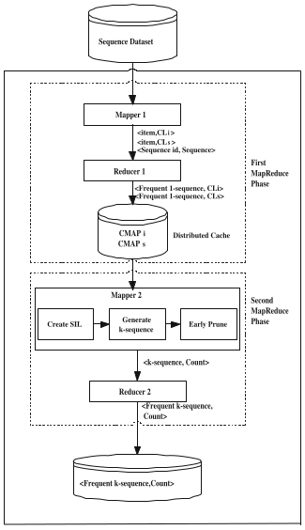
Algorithm - Overview

Slide 17
Algorithm 1.1 - First MapReduce job - Map Phase
Mapper function
Input for ith mapper:
SD_{i} - Sequence Dataset of ith split
min_sup - minimum support count
Output:
(item,L_{s}(item)) pairs
(item,L_{i}(item)) pairs
(sequence id, sequence) for all sequences in SD_{i}
Algorithm:
function MAP1(sequence_id Id, sequence S)
{
Li := CREATE_Li(S)
Ls := CREATE_Ls(S)
for each key i in Li:
output( i, Li(i) )
end for
for each key i in Ls:
output( i, Ls(i) )
end for
output( Id, S )
}

Slide 18
Algorithm 1.2 - First MapReduce job - Map Phase
Create L_{i} function
Input:
A sequence S
Output:
A mapping L_{i} from items to lists of items
Algorithm:
function CREATE_Li(sequence S)
{
Li := new map which maps an item to a list of items
for each itemset IS in S:
for i=0 to size of IS:
for j=i+1 to size of IS:
if Li[IS[i]] has not been initialized:
initialize Li[IS[i]]
end if
Add IS[j] to Li[IS[i]]
end for
end for
end for
return Li
}

Slide 19
Algorithm 1.3 - First MapReduce job - Map Phase
Create L_{s} function
Input:
A sequence S
Output:
A mapping L_{s} from items to lists of items
Algorithm:
function CREATE_Ls(sequence S)
{
Ls := new map which maps an item to a list of items
for each itemset IS1 in S:
for i=0 to size of IS1:
for each itemset IS2 in S that comes before IS1:
for j=0 to size of IS2:
if Ls[IS1[i]] has not been initialized:
initialize Ls[IS1[i]]
end if
Add IS2[j] to Ls[IS1[i]]
end for
end for
end for
end for
return Ls
}

Slide 20
Algorithm 1.4 - First MapReduce job - Reduce phase
Reduce function
Input:
(item, list of all L_{s}(item) from all the mappers) pairs
(item, list of all L_{i}(item) from all the mappers) pairs
(sequence id, sequence) for all sequences in the sequence database
Output:
CMAP_{i} - Co-occurrence Map by itemset extension
CMAP_{s} - Co-occurrence Map by sequence extension
(sequence_id ID, pair(item,position) for all the items in the sequence with id ID) pairs
Algorithm:
function REDUCE1(key k, values v)
{
if k is a sequence id:
HANDLE_SEQUENCES(k,v)
else if k is an item:
HANDLE_CMAP(k,v)
}

Slide 21
Algorithm 1.5 - First MapReduce job - Reduce phase
Handle Sequences function
Input:
(sequence id, sequence) pair
Output:
(sequence id, list of pairs(item,position))
Algorithm:
function HANDLE_SEQUENCES(sequence_id ID, sequence S)
{
i := 1
L := new list which stores pairs of items and their indices
for each itemset IS in v:
for each item j in IS:
insert pair(j,i) in L
end for
i := i+1
end for
output(k,L)
}

Slide 22
Algorithm 1.6 - First MapReduce job - Reduce phase
Handle CMAP function
Input:
(item, list of lists of items)
Output:
(item,Co-occurrence list of item succeeded by itemset extension)
(item,Co-occurrence list of item succeeded by sequence extension)
Algorithm:
function HANDLE_CMAP(item x, list of lists values)
{
Initialize a map COUNT as a mapping from item to integer
for each list L in values:
for each item i in L:
if i is a key present in COUNT:
COUNT[i] := COUNT[i]+1
else
COUNT[i] := 1
end if
end for
end for

Slide 23
Algorithm 1.6 - First MapReduce job - Reduce phase
for each key k in COUNT:
if COUNT[k]>=min_sup:
if values is a list of Li:
output(x,k) to CMAPi
else if values is a list of Ls:
output(x,k) to CMAPs
end if
end if
end for
}

Slide 24
Algorithm 2.1 - Second MapReduce job - Map Phase
Mapper function Input:
ith split of (sequence_id ID, list of pair(item,position) for all the items in the sequence with id ID) pairs data from output of the reducer of the previous MapReduce phase
Output:
(sequence, support count of sequence for the current split)
Algorithm:
function MAP2(sequence_id ID,list of pair(item,position) L)
{
Initialize ItemPosMapping as a mapping from item to list of positions
for each pair p in L:
Add p.position to ItemPosMapping[p.item]
end for
Initialize SIL as a mapping from sequence to a mapping from sequence ID to a list of positions
SIL := CREATE_SIL(ID,ItemPosMapping)
for each key S in SIL which is a 1-sequence:
GENERATE_SEQUENCES(S,SIL)
end for
}

Slide 25
Algorithm 2.2 - Second MapReduce job - Map Phase
Function for creating SIL of 1-sequences
Input:
Sequence id ID
ItemPosMapping, a mapping from item to list of positions of that item in the sequence with given ID
Output:
SIL of all 1-sequences contained in the sequence with the given ID
Algorithm:
function CREATE_SIL(sequence id ID, ItemPosMapping IPM)
{
Initialize SIL as a mapping from a sequence to a mapping from a sequence ID to a list of positions
for each item i which is a key in IPM:
Sequence S := <(i)>
initialize SIL[S]
initialize SIL[S][ID]
SIL[S][ID] := IPM[i]
end for
return SIL
}

Slide 26
Algorithm 2.3 - Second MapReduce job - Map Phase
Function for candidate generation
Input:
CMAP_{i} and CMAP_{s} from distributed cache
Sequence S
SIL
Output:
(sequence, support count) pairs for new candidate sequences
Algorithm:
function GENERATE_SEQUENCES(Sequence S, SIL)
{
lastitem := last item of sequence S
if lastitem is a key in CMAP_{s}:
for each item i in CMAP_{s}(lastitem):
if <(i)> is not a key in SIL:
continue
end if
newSeq := sequence obtained by adding <(lastitem)> at the end of S
if EARLY_PRUNE(newSeq) is false:
Initialize SIL[newSeq]
SIL[newSeq] := CREATE_SIL_SEQUENCE(false,SIL[S],SIL[<(i)>])
support_count := number of rows in SIL[newSeq]

Slide 27
Algorithm 2.3 - Second MapReduce job - Map Phase
if support_count>=1:
output(newSeq,support_count)
GENERATE_SEQUENCES(newSeq,SIL)
end if
end if
end for
end if
if lastitem is a key in CMAP_{i}:
for each item i in CMAP_{i}(lastitem):
if <(i)> is not a key in SIL:
continue
end if
newSeq := sequence obtained by adding lastitem at the end of the last itemset of S
if EARLY_PRUNE(newSeq) is false:
Initialize SIL[newSeq]
SIL[newSeq] := CREATE_SIL_SEQUENCE(true,SIL[S],SIL[<(i)>])
support_count := number of rows in SIL[newSeq]
if support_count>=1:
output(newSeq,support_count)

Slide 28
Algorithm 2.3 - Second MapReduce job - Map Phase
GENERATE_SEQUENCES(newSeq,SIL)
end if
end if
end for
end if
}

Slide 29
Algorithm 2.4 - Second MapReduce job - Map Phase
Function for checking if a sequence is infrequent
Input:
CMAP_{i} and CMAP_{s} from distributed cache
Sequence S to be checked
Output:
true if S is to be pruned, false otherwise
Algorithm:
function EARLY_PRUNE(Sequence S)
{
lastitem := last item in S
IS_{n} := last itemset in S
for every item i in IS_{n} except the last item:
if i is not a key in CMAP_{i} or CMAP_{i}(i) doesnt contain lastitem:
return true
end if
end for
if S has more than one itemsets:
IS_{n-1} := second last itemset in S

Slide 30
Algorithm 2.4 - Second MapReduce job - Map Phase
for every item i in IS_{n-1}:
if i is not a key in CMAP_{s} or CMAP_{s}(i) doesnt contain lastitem:
return true
end if
end for
end if
return false
}

Slide 31
Algorithm 2.5 - Second MapReduce job - Map Phase
Function for creating SIL of new sequences
Input:
itemEx: if true then sequence is extended by itemset extension otherwise by sequence extension
SIL[S]: SIL of sequence S which is to be extended
SIL[item]: SIL of the sequence <(item)>. item is uses to extend S by sequence or itemset extension depending on the value of itemEx to obtain the new sequence
Output:
SIL of the new extended sequence
Algorithm:
function CREATE_SIL_SEQUENCE(boolean itemEx, SIL[S], SIL[<(item)>])
{
Initialize SILnewSeq which is a mapping from sequence ID to list of positions
for every sequence id ID1 in SIL[S]:
for every sequence id ID2 in SIL[item]:
if ID1 is equal to ID2:
Initialize posList as a list of positions
if itemEx is true:
for each position x in SIL[S][ID1]:
for each position y in SIL[item][ID1]:

Slide 32
Algorithm 2.5 - Second MapReduce job - Map Phase
if x is equal to y:
insert x in posList
break
end if
end for
end for
else
for each position x in SIL[S][ID1]:
for each position y in SIL[item][ID1]:
if y>x:
insert y in posList
break
end if
end for
end for
end if

Slide 33
Algorithm 2.5 - Second MapReduce job - Map Phase
if posList is not empty:
Initialize SILnewSeq[ID1]
SILnewSeq[ID1] := posList
end if
break
end if
end for
end for
return SILnewSeq
}

Slide 34
Algorithm 2.6 - Second MapReduce job - Reduce Phase
Reducer function
Input:
(Sequence,list of support counts from different mappers) for different sequences
min_sup: minimum support
Output:
Frequent sequences and their support count
Algorithm:
function REDUCE2(Sequence S, list L of support counts)
{
total_count := 0
for each x in L:
total_count := total_count + x
end for
if total_count>=min_sup:
output(S,total_count)
end if
}

Slide 35
Advantages of DSPC over pre-existing algorithms
Fast support counting using SILs - longer sequences have smaller SILs
CMAP computation is fast even for low minimum support
Exactly two MapReduce jobs - non iterative approach - single database scan
Good scalability
Good speedup
Low communication and scheduling overhead
Less memory intensive compared to other algorithms

Slide 36
Disadvantages of DSPC
Depth first algorithm - low minimum support can cause memory overflow
SIL computation takes O(mn) time - m*n may be large for small minimum support
Long frequent sequences can cause memory overflow
Small minimum support can lead to larger CMAPs - sending CMAP to each node might not be feasible in extreme cases

Slide 37
Observations, Analysis and Improvements

Slide 38
Observations and Analysis
Datasets used: BMSW, MSNBC, FIFA, Kosarak
The time and memory consumed for the execution of the first MapReduce job depends very less on the minimum support. The first MapReduce job mainly depended on the number of sequences in the dataset and the number of distinct items. Time taken ∝ number of sequences, memory consumed ∝ number of distinct items. This was observed in the case of the Kosarak dataset for which the first MapReduce job consumed quite a lot of memory and time whereas in the case of the MSNBC dataset, it consumed very less memory.
The time taken to execute the second MapReduce job mainly depended on the minimum support. It was observed in all the datasets that decreasing the minimum support count led to an increase in the time taken for the execution of the job. Moreover the increase in time taken on decreasing the minimum support is much higher for smaller values of minimum support count. This increase is also higher if the dataset consists of long sequences.

Slide 39
Observations and Analysis
This is clearly observed for the FIFA dataset which had the highest increase in time consumed for decrease in minimum support, followed by the MSNBC dataset, followed by the Kosarak dataset. The lowest increase was observed for the BMSW dataset. FIFA has the highest average sequence length, followed by MSNBC, followed by Kosarak which is finally followed by BMSW.
For smaller values of minimum support, the memory limit often exceeds during the execution of the second MapReduce job. This is especially true for datasets with longer sequences. DSPC follows a depth-first approach for candidate generation. Thus if the dataset consists of long sequences, the number of possible candidate sequences that can arise from each sequence becomes exponentially higher than that in case of a dataset with small sequences for the same minimum support. On account of this, storing the SILs for all the candidate sequences arising from a long sequence becomes a very memory consuming task which may also lead to exceeding the memory limit. Due to this, the memory limit exceeded problem is encountered especially in the case of FIFA and MSNBC for relatively high values of minimum support.

Slide 40
Observations and Analysis
This inference is further reinforced by the fact that MSNBC gives memory limit exceeded for values of minimum support less than 10000 whereas that number is just 100 for BMSW, despite the fact that MNSW has 60000 sequences whereas MSNBC has 32000 which is nearly half of that quantity.
The DSPC algorithm is highly time and memory efficient. The first MapReduce job of the DSPC algorithm calculated CMAPs and CMAPi for large datasets such as Kosarak within the duration of a minute and that too on a virtual cluster hosted on a system with just 8 GB RAM. For all the observations taken, the first MapReduce job executed flawlessly without any memory or time issues. The second MapReduce job worked for all datasets for decent values of the support count and only gave memory limit exceeded error for very small minimum support counts and datasets with long average sequence lengths. Thus if a more powerful cluster is used, the algorithm can perform the sequential pattern mining task in very less time and using very less memory.

Slide 41
Proposed improvements
Removing sequence ID from the implementation of SIL . The datatype of SIL for explaining its concept should be Map<Sequence,Map<Sequence ID,position>>, for implementation purposes it is sufficient and more efficient to use Map<Sequence,position>. For example:
Sequence ID | position list
1 | {3,4}
2 | {1,3}
Sequence | position list
S1 | {3,4}
S2 | {1,2}
Sequence | position list
S2 | {3,7}
Sequence ID | position list
1 | {1,2}
3 | {3,7}
Sequence | position list
S1 | {1,3}
Corresponding new SIL implementation
Original SIL implementation

Slide 42
Proposed Improvements
Improved version of CREATE_SIL_SEQUENCE() algorithm using improved SIL:
function CREATE_SIL_SEQUENCE(boolean itemEx, SIL[S], SIL[<(item)>])
{
Initialize SILnewSeq as a list of positions
if itemEx is true:
x := 0, y := 0
while x<size of SIL[S] and y<size of SIL[<(item)>]:
if SIL[S](x) = SIL[<(item)>](y):
insert SIL[S](x) in SILnewSeq
x := x+1
y := y+1

Slide 43
Proposed Improvements
else if SIL[S](x)<SIL[<(item)>](y):
x := x+1
else
y := y+1
end if
end while
else
y := size of SIL[<(item)>] - 1
while size of SIL[S]>0 and y>=0:
if SIL[<(item)>](y)>SIL[S](0):
insert SIL[<(item)>](y) in SILnewSeq
else
break
end if
end while

Slide 44
Proposed Improvements
end if
return SILnewSeq
}
Above implementation of the CREATE_SIL_SEQUENCE() function has a time complexity of O(m+n) as compared to the time complexity of the original implementation which is O(mn) where m is the size of SIL[S] and n is the size of SIL[<(item)>]. This function is called for every candidate sequence. Thus, using this improved implementation of the function substantially reduces the amount of time taken to mine frequent sequential patterns, especially for large datasets and datasets with longer sequences.

Slide 45
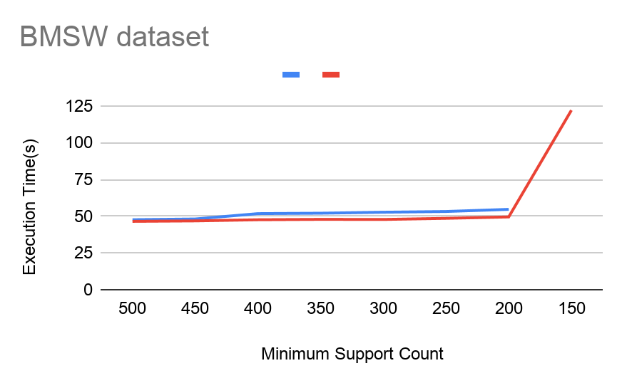
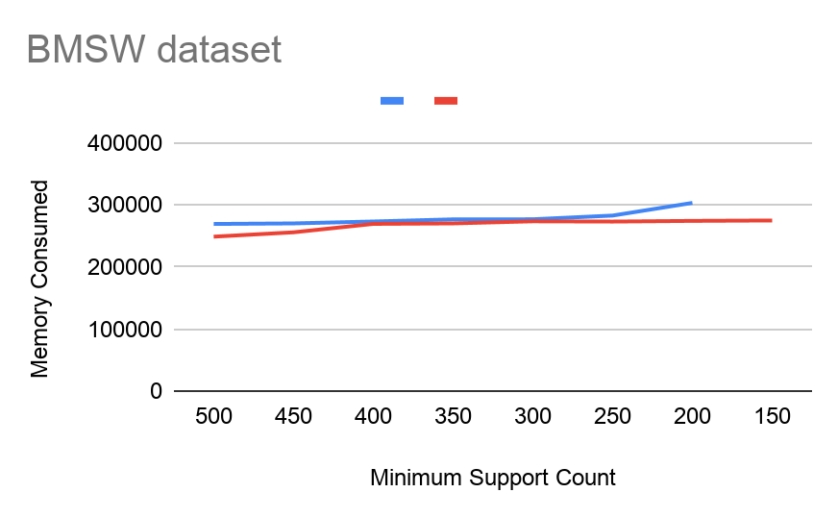
Proposed Improvements
Graphical comparison of performances for various datasets:
Blue line represents original algorithm and Red line represents improved SIL along with improved CREATE_SIL().

Slide 46
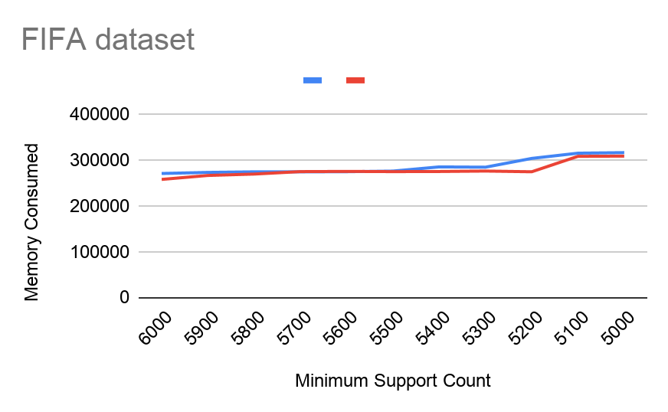
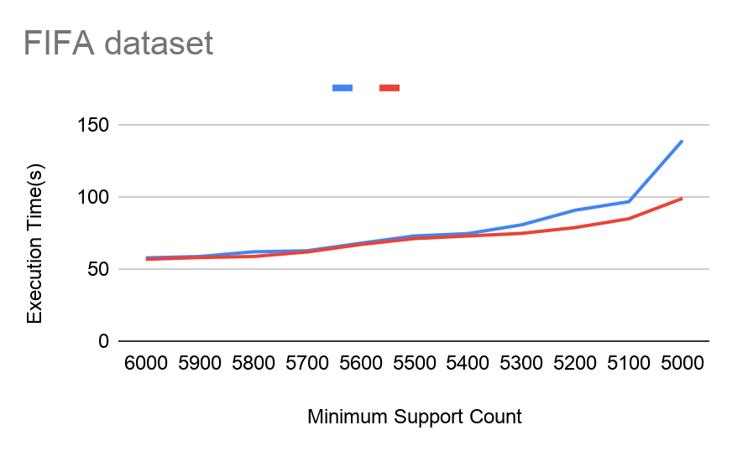
Proposed Improvements

Slide 47
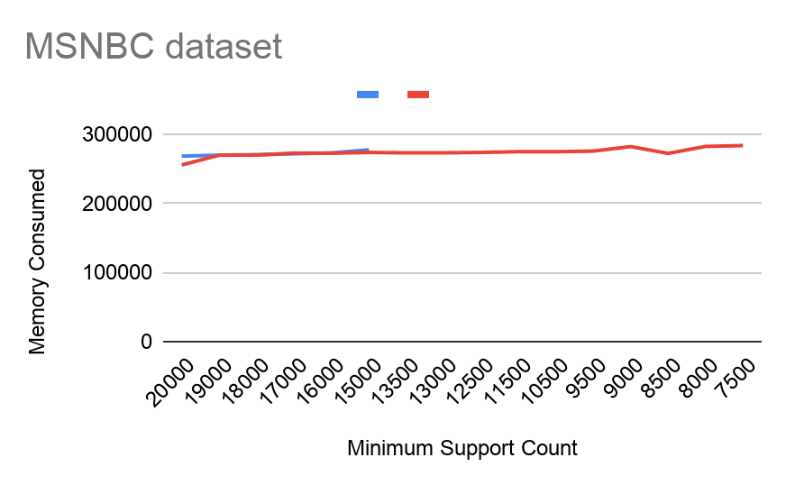
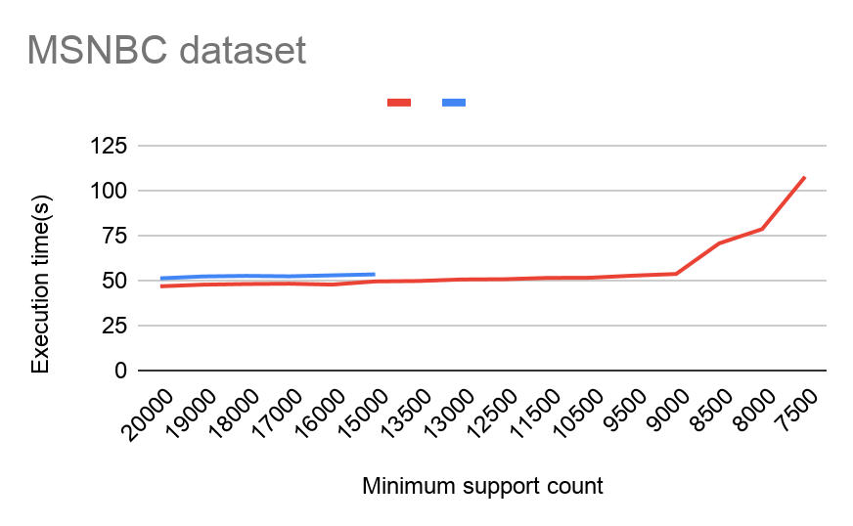
Proposed Improvements

Slide 48
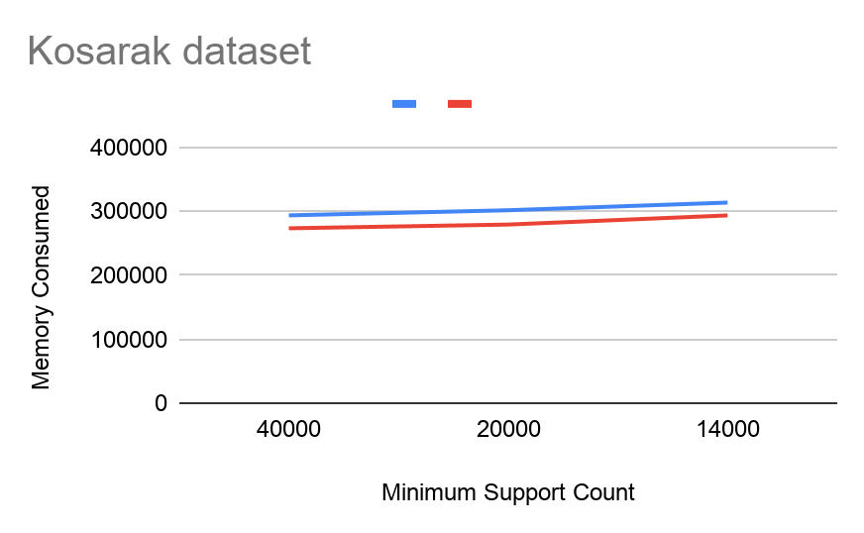
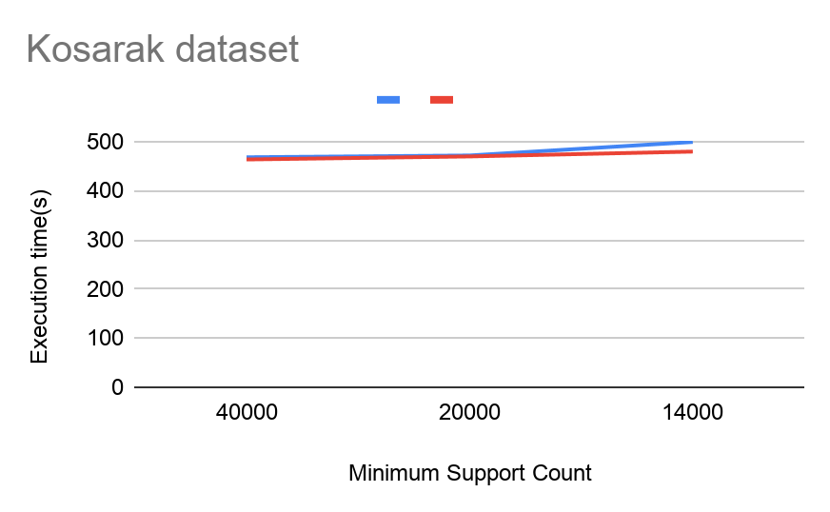
Proposed Improvements

Slide 49
Proposed Improvements
From the observations it is clearly visible that the algorithm performs much better with the proposed modifications. From all the execution time vs minimum support curves, it is observed that with the decrease in minimum support, the difference between execution times of the original algorithm and the improved version keeps increasing. This is expected since the formation of SIL for new sequences in the former takes O(mn) time whereas in the latter it takes O(m+n). This is especially observed in the case of the FIFA dataset which has longer sequences and hence larger values of m and n. Although it is difficult to comment on memory consumption from the above graphs, it is observed that as a general trend, the improved version of the algorithm consumes less memory. The superiority of the improved version in terms of memory consumption can be clearly seen as the improved version gives an output even for those values of minimum support for which the original algorithm produces an error(memory limit exceeded).

Slide 50
Future Work
Incorporation of constraint checks in the DSPC algorithm, mainly time gap constraints.

Slide 51
Challenges faced
Unavailability of cluster
Unavailability of implementations of existing algorithms
Mistakes in algorithm written in the original paper
Limitations of a single machine
Unavailability of a proper source to study MapReduce programming
Recording the time taken for the execution of the algorithm on a dataset

Slide 52
References
A novel mapreduce algorithm for distributed mining of sequential patterns using co-occurrence information - Sumalatha Saleti, R. B. V. Subramanyam
A Survey of Sequential Pattern Mining - Philippe Fournier-Viger, Jerry Chun-Wei Lin, Rage Uday Kiran, Yun Sing Koh, Rincy Thomas
A Survey of Parallel Sequential Pattern Mining - Wensheng Gan, Jerry Chun-Wei Lin, Philippe Fournier-Viger, Han-Chieh Chao, Philip S. Yu
Mining Sequential Patterns: Generalizations and Performance Improvements - Ramakrishnan Srikant, Rakesh Agrawal
Sequential PAttern Mining using A Bitmap Representation - Jay Ayres, Johannes Gehrke, Tomi Yiu, Jason Flannick
PrefixSpan: Mining Sequential Patterns Efficiently by Prefix-Projected Pattern Growth - Jian Pei, Jiawei Han, Behzad Mortazavi-Asl, Helen Pinto, Qiming Chen, Umeshwar Dayal, Mei-Chun Hsu
Applications of Pattern Discovery Using Sequential Data Mining - Manish Gupta, Jiawei Han

Slide 53
Thank you

